Slide 1
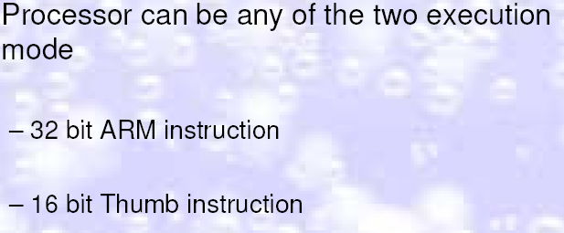

Slide 2

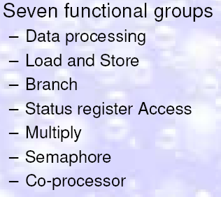

Slide 3
Main features of the ARM Instruction Set
All instructions are 32 bits long.
• Most instructions execute in a single cycle.
• Every instruction can be conditionally executed.
• A load/store architecture
– Data processing instructions act only on registers
• Three operand format
• Combined ALU and shifter for high speed bit manipulation
– Specific memory access instructions with powerful auto-indexing addressing modes.
• 32 bit and 8 bit data types
– and also 16 bit data types on ARM Architecture v4.
• Flexible multiple register load and store instructions
• Instruction set extension via coprocessors

Slide 4
Data processing Instructions
• Largest family of ARM instructions, all sharing the same
instruction format.
• Contains:
– Arithmetic operations
– Comparisons (no results - just set condition codes)
– Logical operations
– Data movement between registers
This is a load / store architecture
– These instruction only work on registers, NOT on memory.
• Each of them perform a specific operation on one or two operands.
– First operand is always a register - Rn
– Second operand sent to the ALU via barrel shifter.

Slide 5
The Barrel Shifter
The ARM doesn’t have actual shift instructions.
• Instead it has a barrel shifter which provides a
mechanism to carry out shifts as part of other
instructions.
• So what operations does the barrel shifter support?

Slide 6
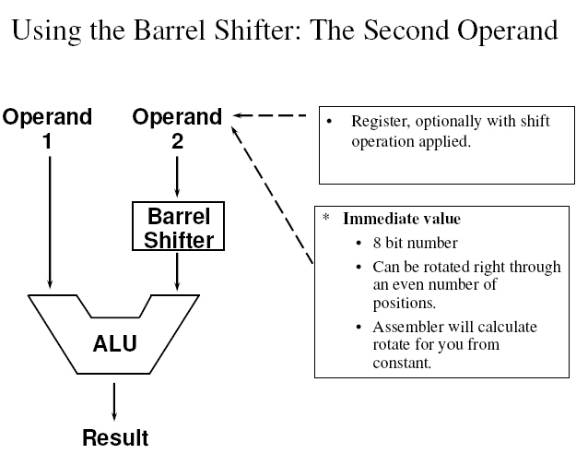
Using the Barrel Shifter: The Second Operand

Slide 7
Second Operand : Shifted Register
If no shift is specified then a default shift is applied:
LSL #0
– i.e. barrel shifter has no effect on value in register.

Slide 8
Second Operand : Immediate Value
There is no single instruction which will load a 32
bit immediate constant into a register without performing a data load from memory.
– All ARM instructions are 32 bits long
– ARM instructions do not use the instruction stream as
data.
• The data processing instruction format has 12 bits
available for operand2
– If used directly this would only give a range of 4096.
Instead it is used to store 8 bit constants, giving a range of 0 - 255.

Slide 9
Second Operand : Immediate Value
These 8 bits can then be rotated right through an even number of positions (ie RORs by 0, 2, 4,..30).
– This gives a much larger range of constants that can be directly
loaded, though some constants will still need to be loaded from memory.
• This gives us:
– 0 - 255 [0 - 0xff]
– 256,260,264,..,1020 [0x100-0x3fc, step 4, 0x40-0xff ror 30]
– 1024,1040,1056,..,4080 [0x400-0xff0, step 16, 0x40-0xff ror 28]
– 4096,4160, 4224,..,16320 [0x1000-0x3fc0, step 64, 0x40-0xff ror 26]

Slide 10
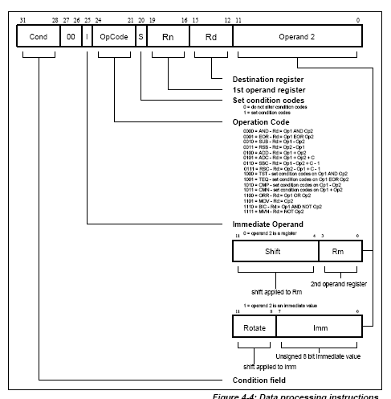

Slide 11
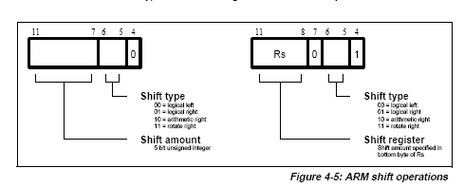

Slide 12
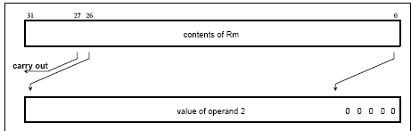
Logical Shift Left

Slide 13
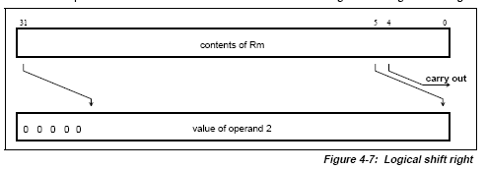
Logical Shift Right

Slide 14
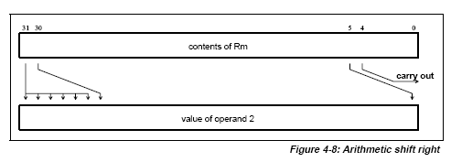
Arithmetic shift right

Slide 15
Second Operand : Immediate Value
These can be loaded using, for example:
– MOV r0, #0x40, 26 ; => MOV r0, #0x1000 (ie 4096)
• To make this easier, the assembler will convert to this form
for us if simply given the required constant:
– MOV r0, #4096 ; => MOV r0, #0x1000 (ie 0x40 ror 26)
• The bitwise complements can also be formed using MVN:
– MOV r0, #0xFFFFFFFF ; assembles to MVN r0, #0
• If the required constant cannot be generated, an error will
be reported.

Slide 16
Loading full 32 bit constants
Although the MOV/MVN mechanism will load a
large range of constants into a register, sometimes this mechanism will not generate the required constant.
• Therefore, the assembler also provides a method which will load ANY 32 bit constant:
– LDR rd,=numeric constant
• If the constant can be constructed using either a
MOV or MVN then this will be the instruction
actually generated.

Slide 17
Otherwise, the assembler will produce an LDR instruction with a PC-relative address to read the constant from a literal pool.
– LDR r0,=0x42 ; generates MOV r0,#0x42
– LDR r0,=0x55555555 ; generate LDR r0,[pc, offset to literal pool]
• As this mechanism will always generate the
best instruction for a given case, it is the
recommended way of loading constants.

Slide 18

Move Instructions

Slide 19
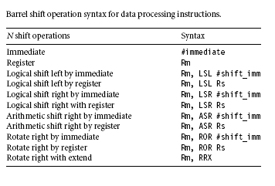

Slide 20
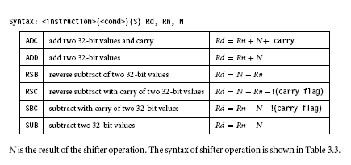
Arithmetic Instructions

Slide 21
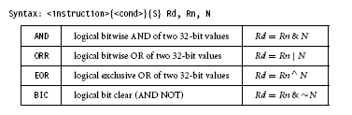
Logical Instructions

Slide 22
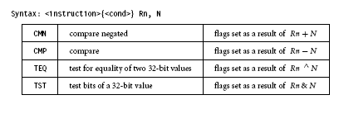
Comparison Instructions

Slide 23
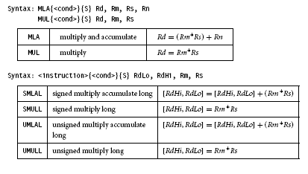
Multiply Instructions

Slide 24
Table 14. Condition code suffixes
Suffix Meaning
EQ Equal
NE Not equal
CS Carry set (identical to HS)
HS Unsigned higher or same (identical to CS)
CC Carry clear (identical to LO)
LO Unsigned lower (identical to CC)
MI Minus or negative result
PL Positive or zero result
VS Overflow
VC No overflow
HI Unsigned higher
LS Unsigned lower or same
GE Signed greater than or equal
LT Signed less than
GT Signed greater than
LE Signed less than or equal
AL Always (this is the default)

Slide 25
Load Store Instructions
Load register loads the contents of the memory location to the register
Store register stores the contents of the register to the memory location specified
Single Register
Multiple Register
Swap

Slide 26

Single Register Load-Store Instructions

Slide 27
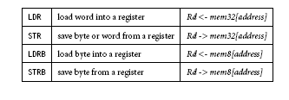

Slide 28
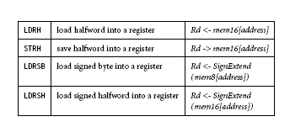

Slide 29
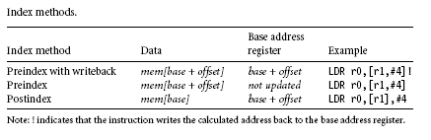
Single Register Load-Store Addressing Modes

Slide 30
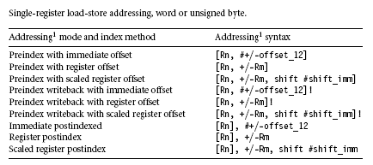

Slide 31
Immediate Addressing Mode
Preindex
Op{type}{<cond>}Rt ,[Rn,#{offset}]
Preindex with write back
Op{type}{<cond>}Rt,[Rn,#{offset}]!
Post Index
Op{type}{<cond>}Rt,[Rn],#offset
Type=B,SB,H,SH

Slide 32
Register Addressing Mode
Preindex
Op{type}{<cond>}Rt ,[Rn,{Rs}]
Preindex with write back
Op{type}{<cond>}Rt,[Rn,{Rs}]!
Post Index
Op{type}{<cond>}Rt,[Rn],Rs
Rs stores the offset data

Slide 33
Scaled Register Addressing Mode
Preindex
Op{type}{<cond>}Rt ,[Rn,{Rm,#offset}]
Preindex with write back
Op{type}{<cond>}Rt,[Rn,{Rm,#offset}]!
Post Index
Op{type}{<cond>}Rt,[Rn],Rm,#offset
Note:Barrel shift cannot be used for signed byte, half word, signed half word

Slide 34
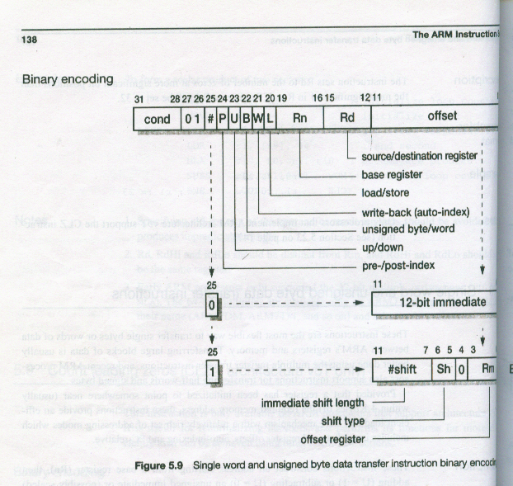

Slide 35
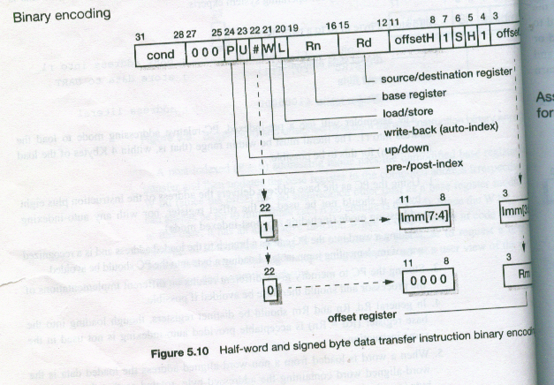

Slide 36
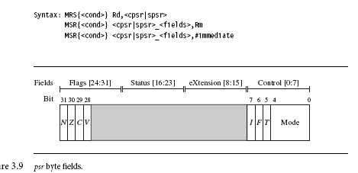
Program Status Register Instructions

Slide 37
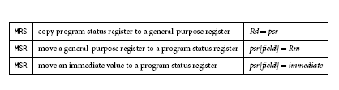

Slide 38
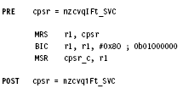

Slide 39

Coprocessor Instructions

Slide 40
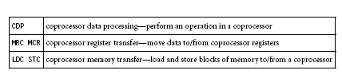

Slide 41
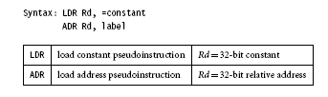
Loading Constants

